Slide 1
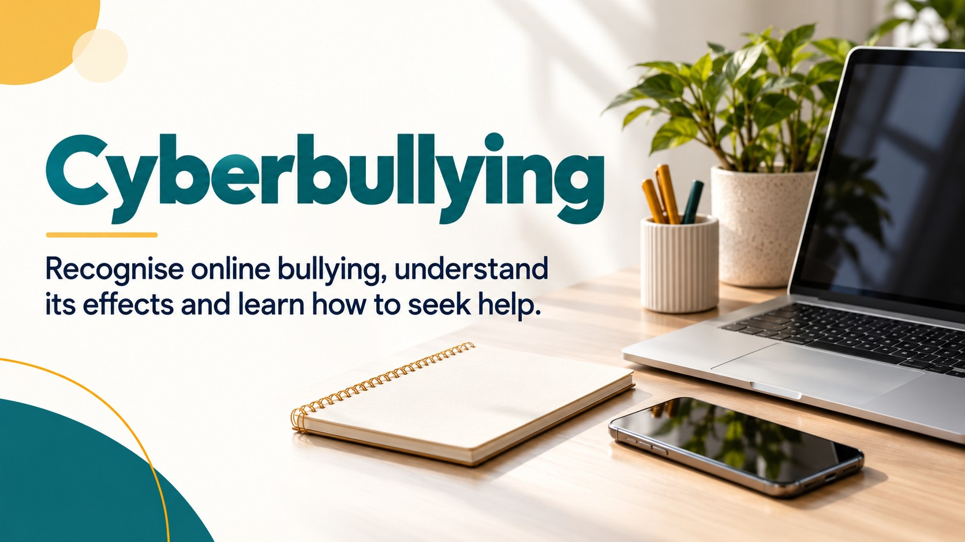
Notes:
Source: Oxford International Lower Secondary Computing Student Book 7, Unit 2, section 2.3 Protect your computer, printed pages 42–45, and section 2.4 Cyberbullying, printed pages 46–49. Classroom adaptation of approved slide content. Generated visuals are illustrative examples, not records of actual events.

Slide 2

Notes:
Source: Oxford International Lower Secondary Computing Student Book 7, Unit 2, section 2.3 Protect your computer, printed pages 42–45, and section 2.4 Cyberbullying, printed pages 46–49. Classroom adaptation of approved slide content. Generated visuals are illustrative examples, not records of actual events.

Slide 3
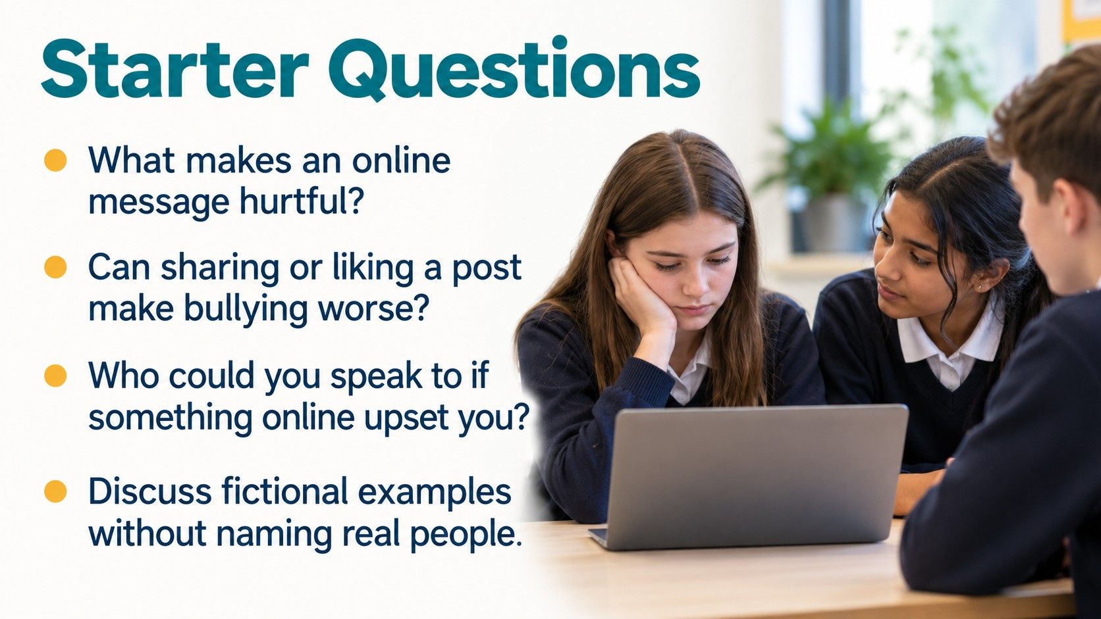
Notes:
Source: Oxford International Lower Secondary Computing Student Book 7, Unit 2, section 2.3 Protect your computer, printed pages 42–45, and section 2.4 Cyberbullying, printed pages 46–49. Classroom adaptation of approved slide content. Generated visuals are illustrative examples, not records of actual events.

Slide 4
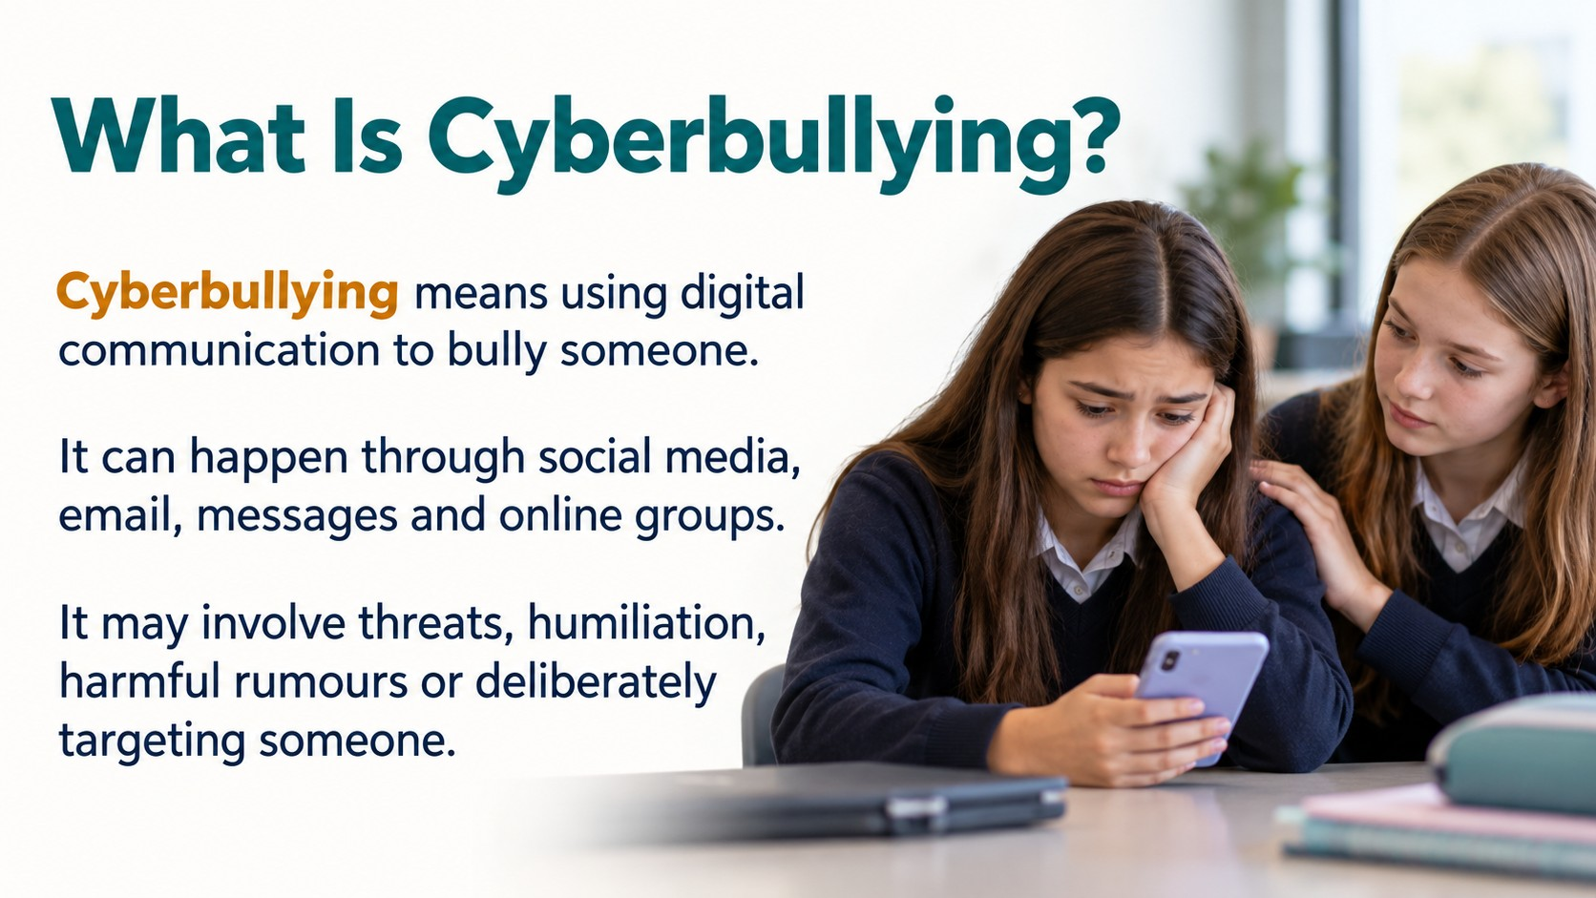
Notes:
Source: Oxford International Lower Secondary Computing Student Book 7, Unit 2, section 2.3 Protect your computer, printed pages 42–45, and section 2.4 Cyberbullying, printed pages 46–49. Classroom adaptation of approved slide content. Generated visuals are illustrative examples, not records of actual events.

Slide 5
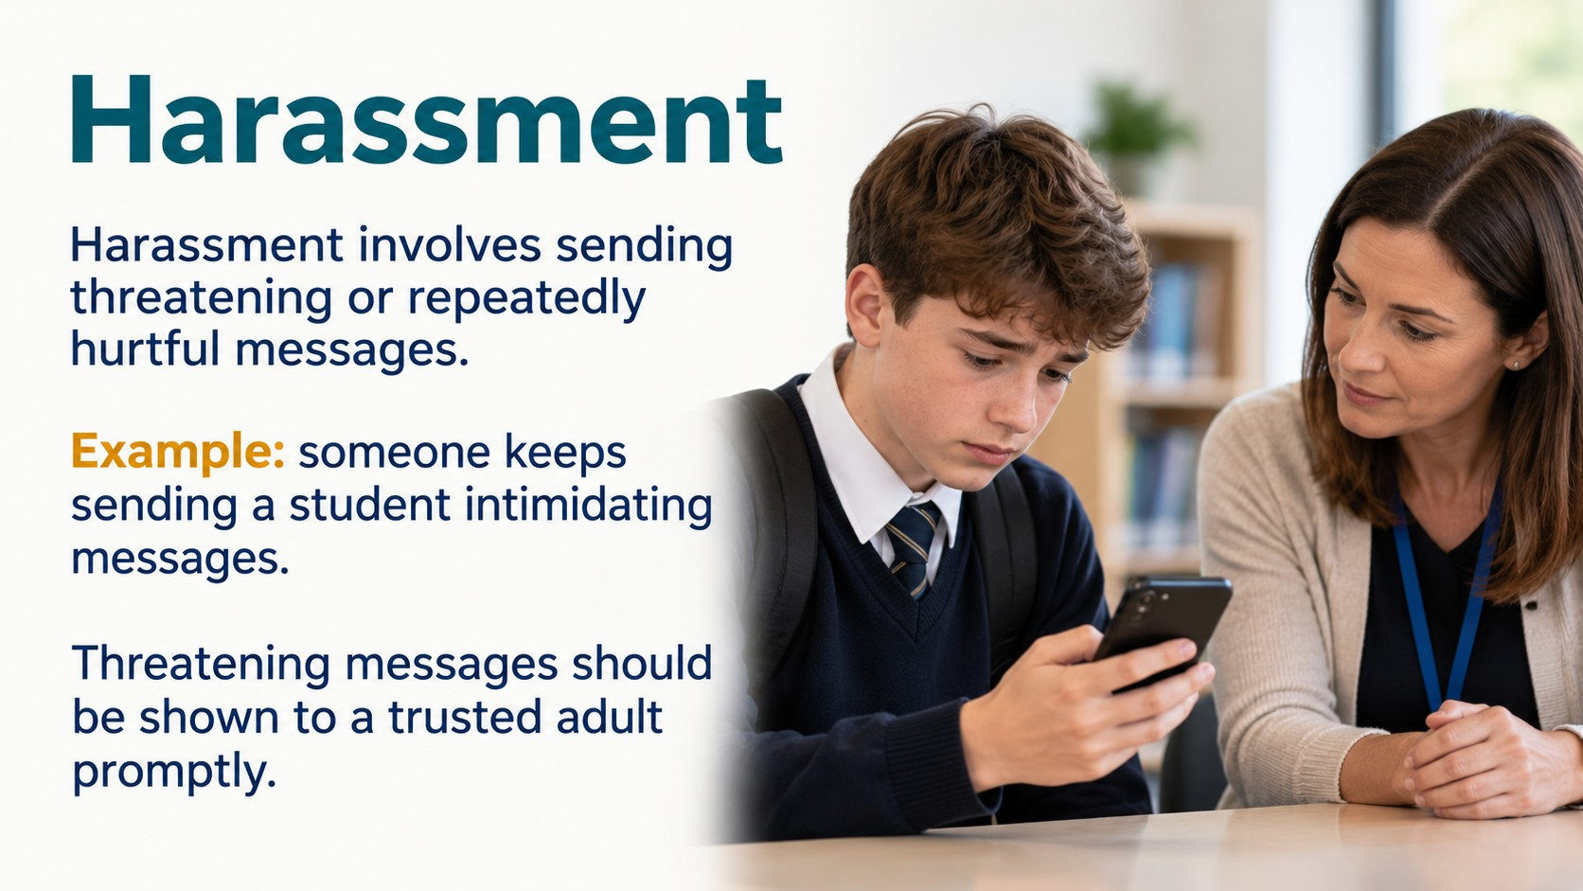
Notes:
Source: Oxford International Lower Secondary Computing Student Book 7, Unit 2, section 2.3 Protect your computer, printed pages 42–45, and section 2.4 Cyberbullying, printed pages 46–49. Classroom adaptation of approved slide content. Generated visuals are illustrative examples, not records of actual events.

Slide 6
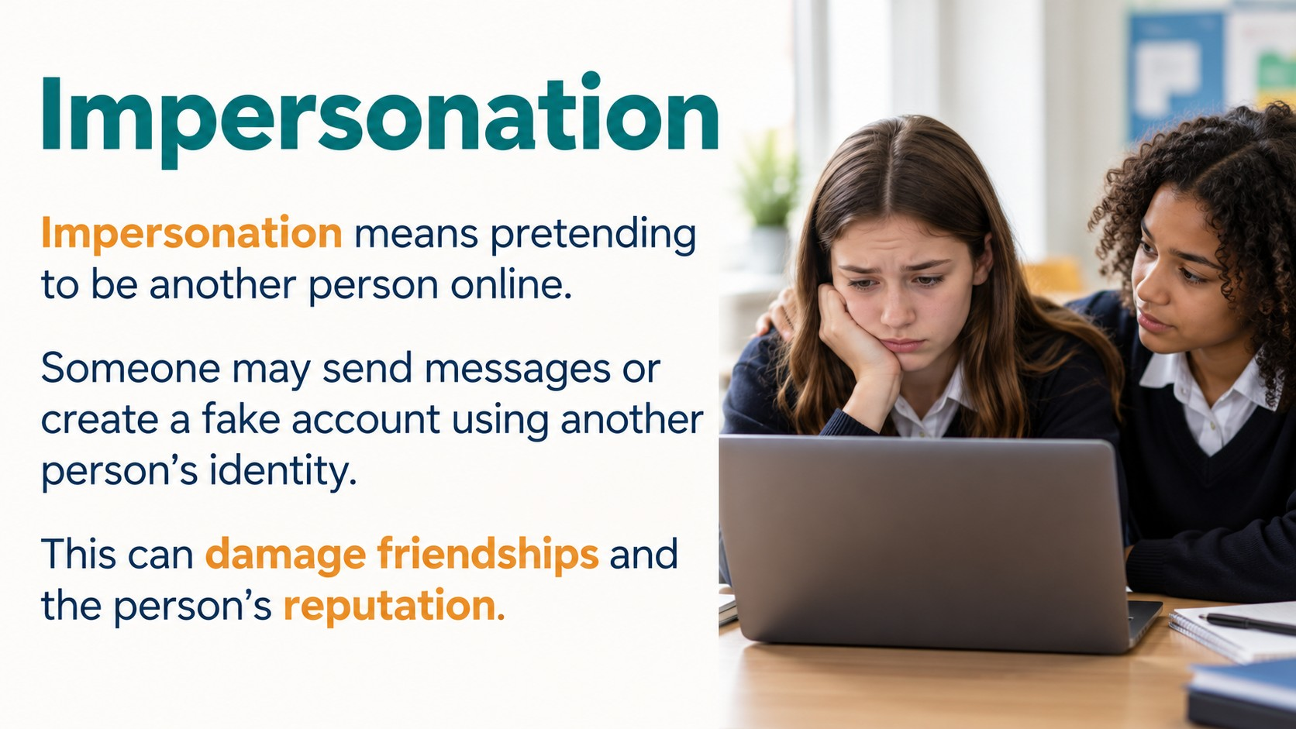
Notes:
Source: Oxford International Lower Secondary Computing Student Book 7, Unit 2, section 2.3 Protect your computer, printed pages 42–45, and section 2.4 Cyberbullying, printed pages 46–49. Classroom adaptation of approved slide content. Generated visuals are illustrative examples, not records of actual events.

Slide 7
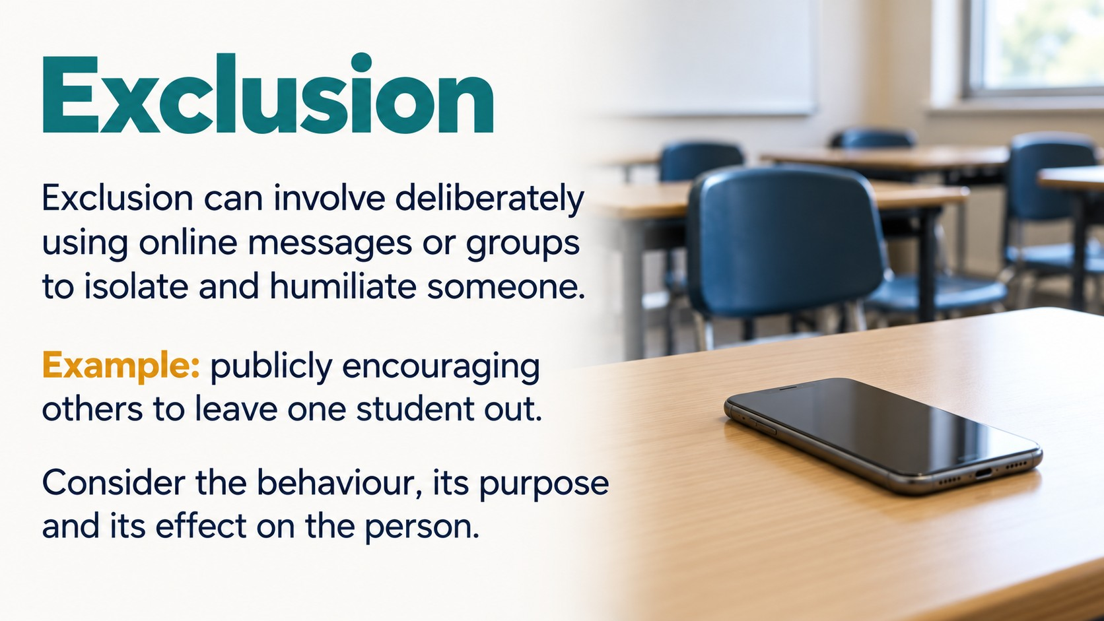
Notes:
Source: Oxford International Lower Secondary Computing Student Book 7, Unit 2, section 2.3 Protect your computer, printed pages 42–45, and section 2.4 Cyberbullying, printed pages 46–49. Classroom adaptation of approved slide content. Generated visuals are illustrative examples, not records of actual events.

Slide 8

Notes:
Source: Oxford International Lower Secondary Computing Student Book 7, Unit 2, section 2.3 Protect your computer, printed pages 42–45, and section 2.4 Cyberbullying, printed pages 46–49. Classroom adaptation of approved slide content. Generated visuals are illustrative examples, not records of actual events.

Slide 9
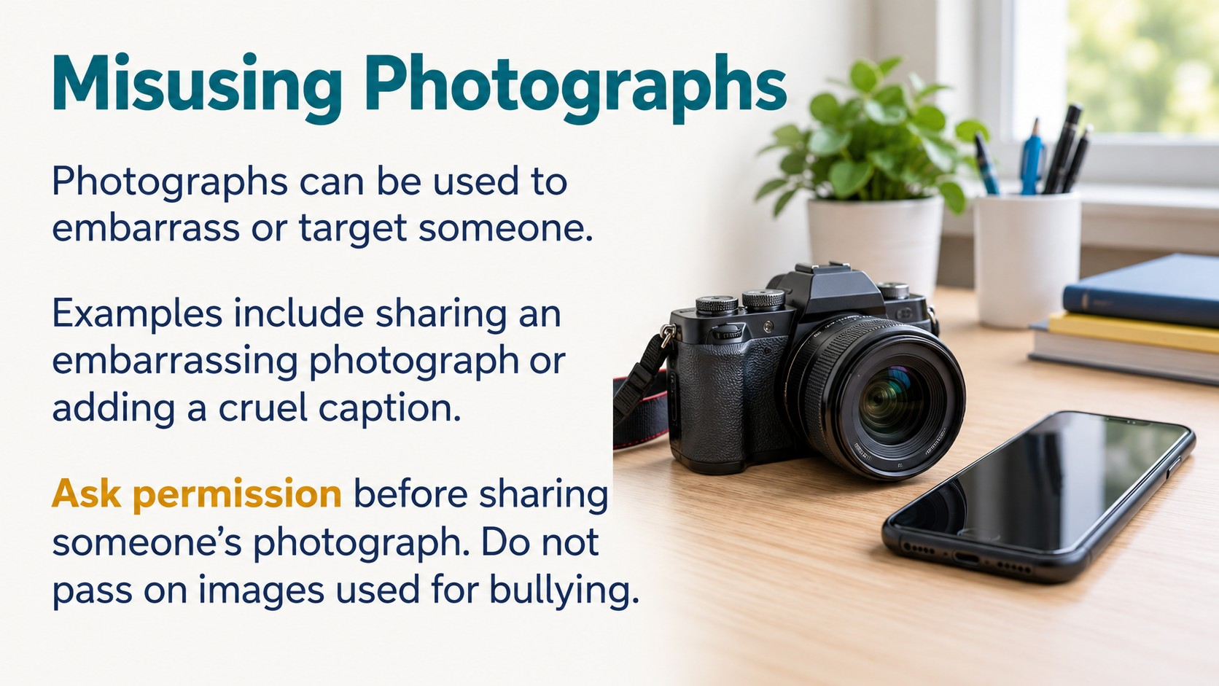
Notes:
Source: Oxford International Lower Secondary Computing Student Book 7, Unit 2, section 2.3 Protect your computer, printed pages 42–45, and section 2.4 Cyberbullying, printed pages 46–49. Classroom adaptation of approved slide content. Generated visuals are illustrative examples, not records of actual events.

Slide 10
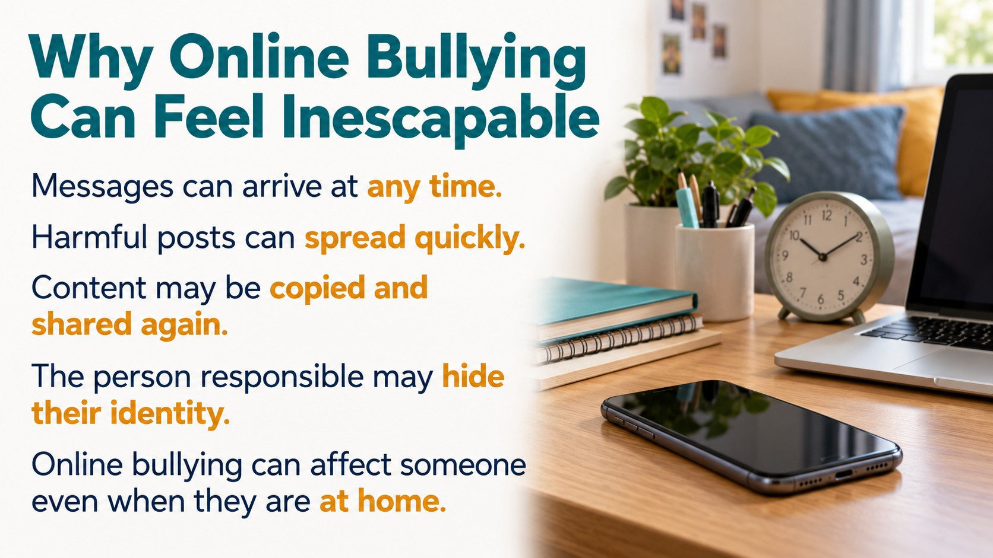
Notes:
Source: Oxford International Lower Secondary Computing Student Book 7, Unit 2, section 2.3 Protect your computer, printed pages 42–45, and section 2.4 Cyberbullying, printed pages 46–49. Classroom adaptation of approved slide content. Generated visuals are illustrative examples, not records of actual events.

Slide 11
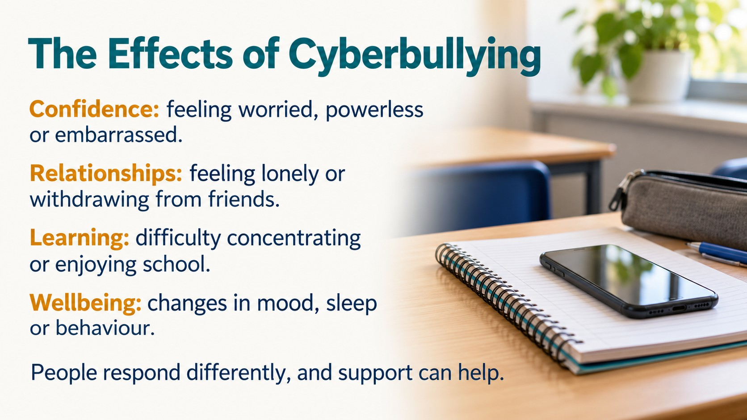
Notes:
Source: Oxford International Lower Secondary Computing Student Book 7, Unit 2, section 2.3 Protect your computer, printed pages 42–45, and section 2.4 Cyberbullying, printed pages 46–49. Classroom adaptation of approved slide content. Generated visuals are illustrative examples, not records of actual events.

Slide 12
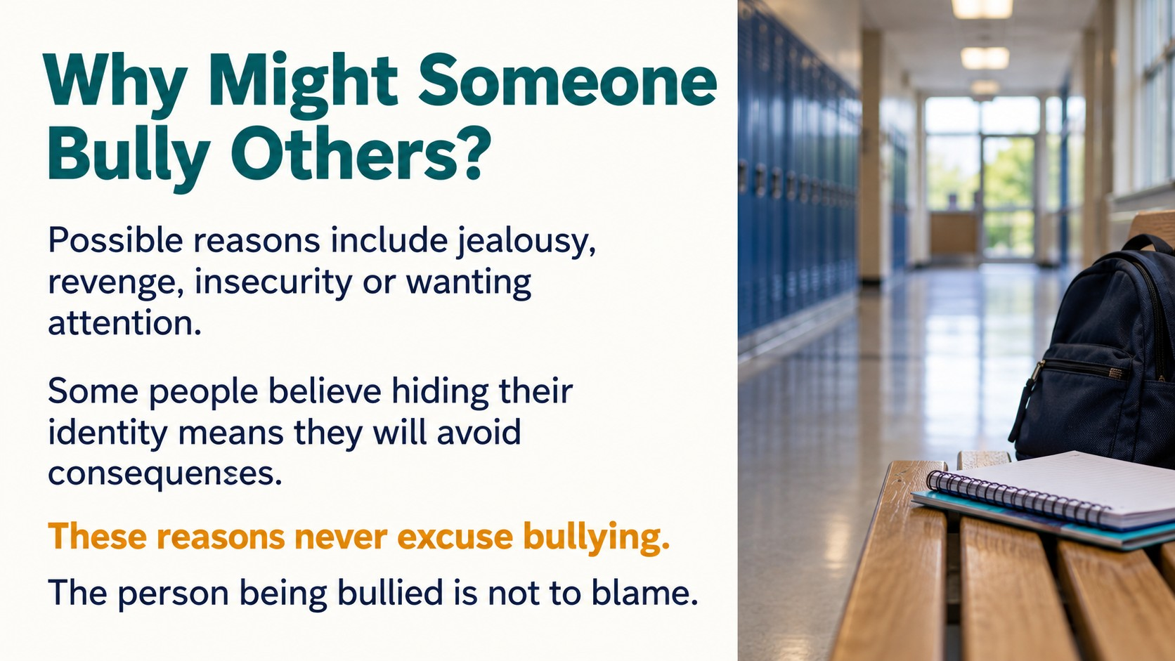
Notes:
Source: Oxford International Lower Secondary Computing Student Book 7, Unit 2, section 2.3 Protect your computer, printed pages 42–45, and section 2.4 Cyberbullying, printed pages 46–49. Classroom adaptation of approved slide content. Generated visuals are illustrative examples, not records of actual events.

Slide 13
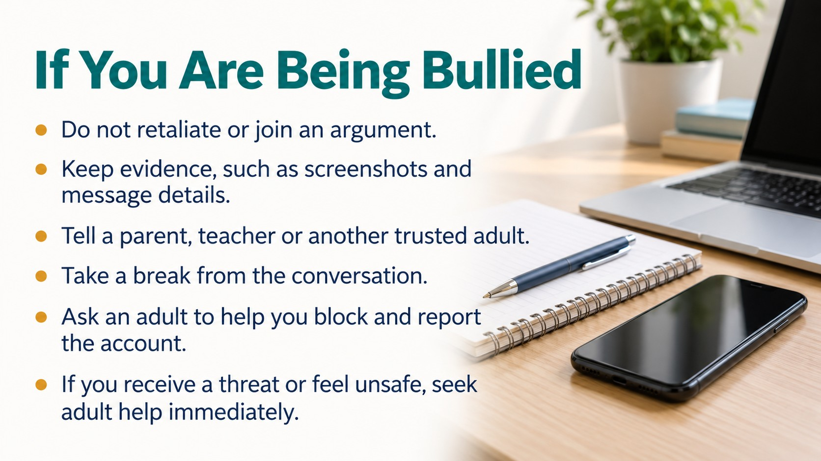
Notes:
Source: Oxford International Lower Secondary Computing Student Book 7, Unit 2, section 2.3 Protect your computer, printed pages 42–45, and section 2.4 Cyberbullying, printed pages 46–49. Classroom adaptation of approved slide content. Generated visuals are illustrative examples, not records of actual events.

Slide 14

Notes:
Source: Oxford International Lower Secondary Computing Student Book 7, Unit 2, section 2.3 Protect your computer, printed pages 42–45, and section 2.4 Cyberbullying, printed pages 46–49. Classroom adaptation of approved slide content. Generated visuals are illustrative examples, not records of actual events.

Slide 15

Notes:
Source: Oxford International Lower Secondary Computing Student Book 7, Unit 2, section 2.3 Protect your computer, printed pages 42–45, and section 2.4 Cyberbullying, printed pages 46–49. Classroom adaptation of approved slide content. Generated visuals are illustrative examples, not records of actual events.

Slide 16
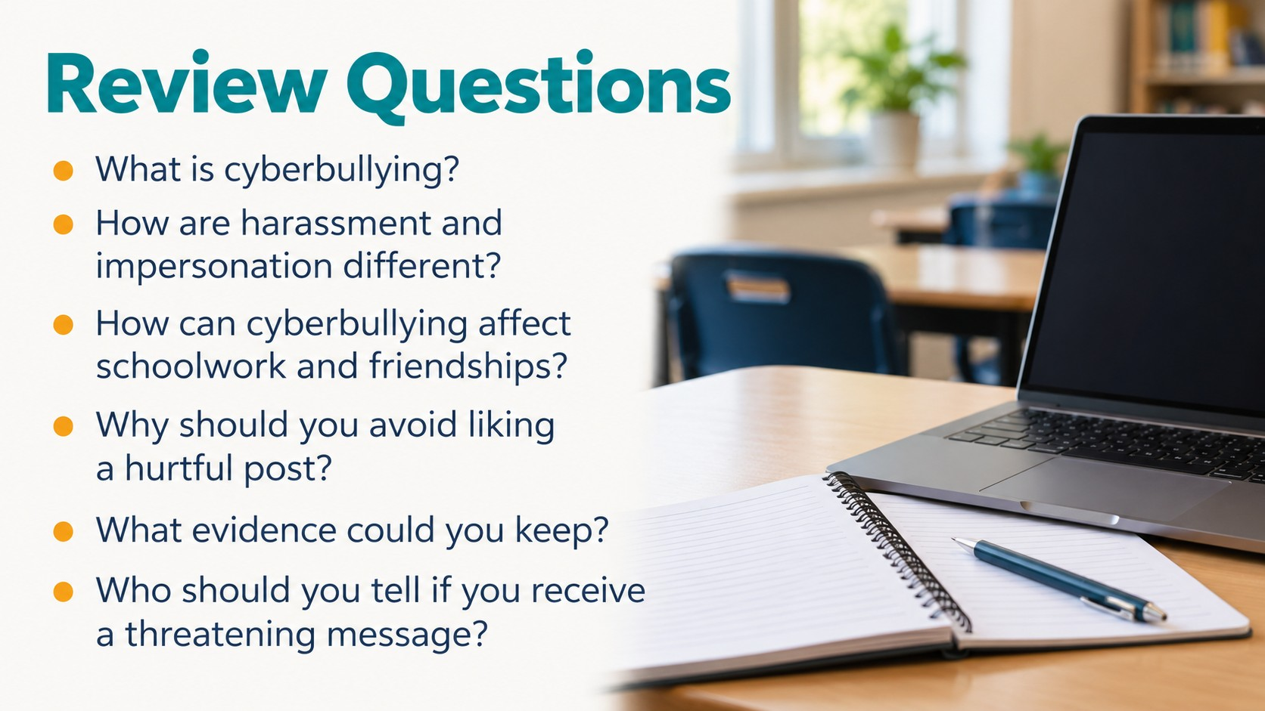
Notes:
Source: Oxford International Lower Secondary Computing Student Book 7, Unit 2, section 2.3 Protect your computer, printed pages 42–45, and section 2.4 Cyberbullying, printed pages 46–49. Classroom adaptation of approved slide content. Generated visuals are illustrative examples, not records of actual events.

